Slide 1



The Predictive Edge: Stacking Ensemble for Smarter HR Decision-Making
By UDOCHI OGBONNA

Slide 2
PROBLEM OVERVIEW
Employee attrition refers to the natural process of employees voluntarily or involuntarily leaving a company or organization. According to Gallup, an average of 22% of employees depart annually, requiring replacement over a 12-month period. Furthermore, SHRM reports that approximately 45% of employees leave within the first two years. This trend can be concerning for organizations, as it may indicate issues with:- Recruitment and selection processes- Onboarding and integration- Employee engagement and satisfaction- Career development and growth opportunities- Managerial support and leadership.
In this case study, we aim to:
1. Identify the key factors contributing to employee attrition.
2. Develop a predictive model capable of classifying employee attrition.
By exploring these factors and building a predictive model, we hope to provide insights for organizations to address employee attrition and improve retention strategies.

Slide 3
METHODOLOGY
1.DATA COLLECTION :
- collect relevant data on employee attributes, performance, and exit information
2. EXPLORATORY DATA ANALYSIS:
- analyze data distribution, summary statistics, and correlations
visualize data using plots and charts to understand trends and patterns
3. FEATURE ENGINEERING:
extract relevant features from data, such as employee tenure, performance ratings, and job title
- create new features through feature transformations and combinations
4. DATA PREPROCESSING AND FEATURE IMPORTANCE/SELECTION:
- Clean and preprocess data by encoding categorical variables, and normalizing/scale data
Features scaling of datasets to evaluate feature importance
- Select most relevant features for model development

Slide 4
METHODOLOGY continued
5. MODEL DEVELOPMENT:
train machine learning models using selected features and algorithms.
6. HYPERPARAMETER OPTIMIZATION:
- tune models using hyperparameter optimization techniques
use techniques like grid search to find optimal hyperparameters.
7. EVALUATION OF METRICS, COMPARISON, AND SELECTION:
evaluate model performance using metrics like accuracy, precision, recall, f1-score, and ROC-AUC
compare models and select the best-performing one
8 APPLYING STACKING ENSEMBLE TECHNIQUE
- choose base learners and a meta-learner that complement each other in terms of strengths and weaknesses.

Slide 5
METHODOLOGY continued
9. PRODUCTIONIZATION:
metrics evaluation
- deploy the selected model in a production-ready environment
monitor model performance and retrain as needed
10. POTENTIAL BENEFITS AND RECOMMENDATION:
identify potential benefits of using the predictive model, such as reduced staff turnover rates and improved employee retention
- provide recommendations for HR and management to utilize the model and improve employee satisfaction and engagement.

Slide 6
DATA COLLECTION AND PREPROCESSING:
The dataset contains 35 columns with 1,058 entries. It has int64(27) and object (8).
The Oldest person is 60 years while the youngest is 18 years old. Attrition is classified as 0 and 1. The highest monthly income earner is approximately $20,000, the average monthly income earner is $4,900 while the least earns $1,009.
It shows 3 department, 6 educational field and job role is 9.
There are no missing and no duplicated values.

Slide 7
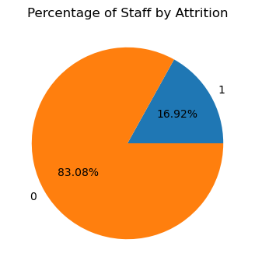
EXPLORATORY DATA ANALYSIS
UNIVARIATE ANALYSIS
STAFF ATTRITION
This shows a notable class imbalance, with 17% of employees having attributed. This significant disparity between the minority class (attributed) and majority class (not attributed) requires careful consideration in modeling and prediction to avoid bias and ensure accurate results.

Slide 8
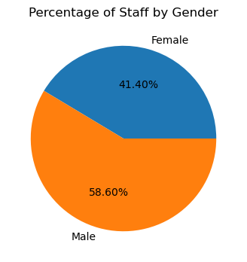
EXPLORATORY DATA ANALYSIS
UNIVARIATE ANALYSIS
GENDER
Gender ratio is male (59%) while female (41%).

Slide 9
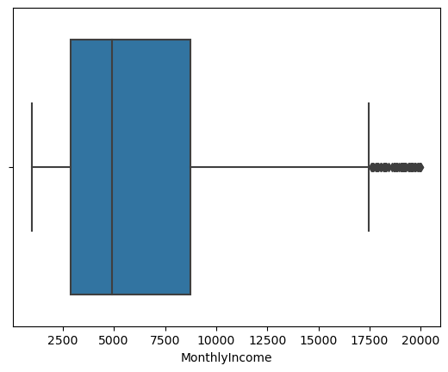
EXPLORATORY DATA ANALYSIS
UNIVARIATE ANALYSIS
MONTLY INCOME DISTRIBUTION
The presence of outliers from (17,500 −19,990) in the monthly income data suggests that there are individuals who earn significantly more than the average income of $5000. These outliers could be due to various factors such as:
High-paying jobs or professions
Errors in data entry or collection
Other factors not accounted for in the data
These outliers can significantly impact the distribution of the data and may affect the accuracy of models trained on this data.

Slide 10
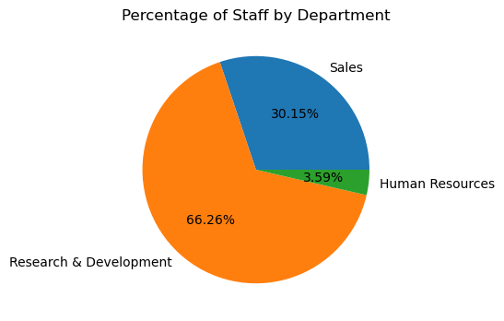
EXPLORATORY DATA ANALYSIS
UNIVARIATE ANALYSIS
Percentage of Staff by Department
About 66% of the staff are in R&D, 30% in sales while 4% are in HR.

Slide 11
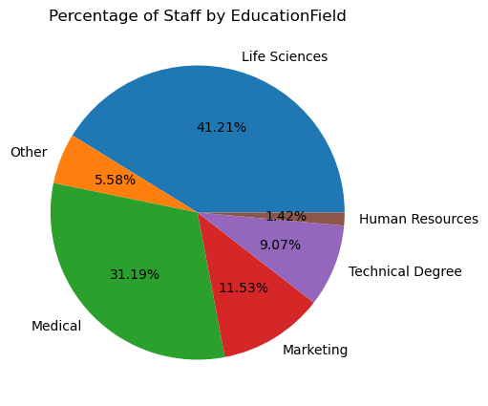
EXPLORATORY DATA ANALYSIS
UNIVARIATE ANALYSIS
Percentage of Staff by Educational Field
The data reveals
Life sciences: 41%
Medical: 31%
Sales: 11%
Others: 17% (which includes HR, technical and other support functions)
This distribution suggests that the company is likely focused on developing and commercializing life sciences and medical products or services. The high percentage of staff with life sciences and medical backgrounds indicates a strong technical expertise in these areas the outliers as seen on the monthly income chart,
The relatively smaller proportion of staff with sales backgrounds (11%) may indicate that the company is more focused on research and development, and may be relying on external partners or channels for sales and marketing.

Slide 12
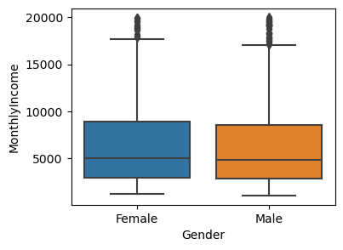
EXPLORATORY DATA ANALYSIS
Bivariate Analysis
Relationship between gender vs monthly income
Gender does not determine the earning capacity of the staff

Slide 13
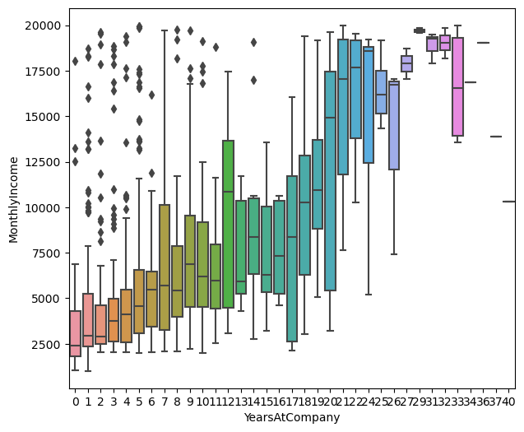
EXPLORATORY DATA ANALYSIS
Bivariate Analysis
Relationship between Years at the company vs monthly income
The data shows that employees who stay with the company longer tend to earn more, but there are some exceptions that could indicate:
Fast-tracked promotions for high performers
Specialized skills leading to higher pay
Successful salary negotiations
- Data errors
These exceptions can help the company identify areas to improve its compensation and retention strategies.

Slide 14
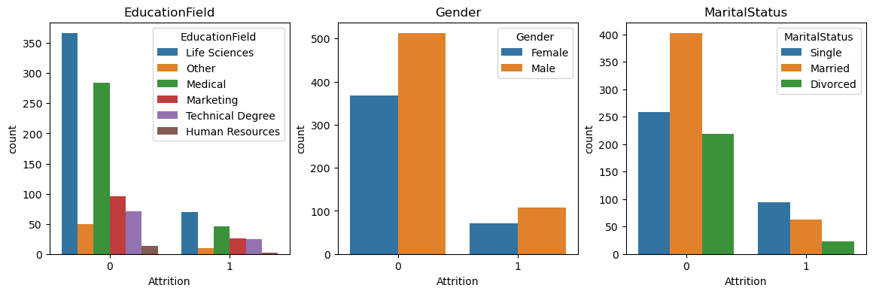
EXPLORATORY DATA ANALYSIS
Bivariate Analysis
Relationship between Attrition and categorical variables.
Singles, in Life Sciences and Medical have a high attrition rate.

Slide 15
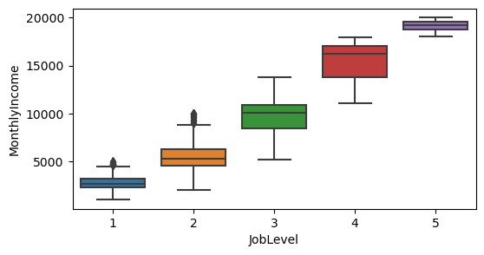
EXPLORATORY DATA ANALYSIS
Bivariate Analysis
Relationship between the job level vs the monthly income.
The data shows that the job levels are in 5 category and has a positive correlation with the monthly income. The chart depicts an average earning as low as 2,600 and others earn as high as 19,000 USD

Slide 16
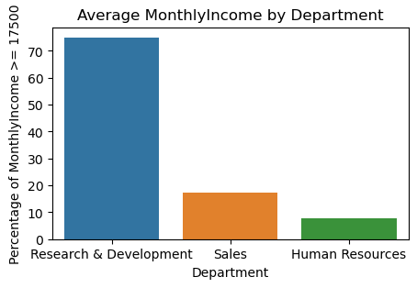
EXPLORATORY DATA ANALYSIS
BIVARIATE ANALYSIS
RELATIONSHIP BETWEEN THE AVERAGE MONTHLYINCOME >= $17,500 BY DEPARTMENT
Based on insight from the outliers, it appears that:
75% of Research & Development (R&D) department employees earn above $17,500, which is a significant proportion.
17% of Sales department employees earn above $17,500, which is a relatively smaller proportion compared to R&D.
7% of Human Resources department employees earn above $17,500, which is the smallest

Slide 17
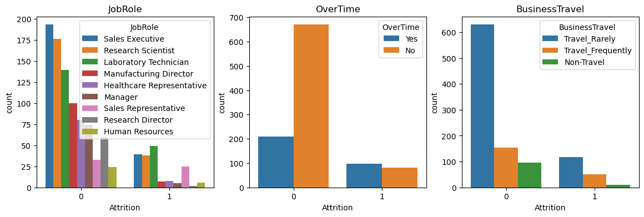
EXPLORATORY DATA ANALYSIS
BIVARIATE ANALYSIS
RELATIONSHIP BETWEEN ATTRITION AND CATEGORICAL VARIABLES.
Attrition risk is higher among Laboratory Technicians, Sales Executives, Research Scientists, and Sales Representatives, as well as employees with minimal travel demands. Overtime has no significant impact on attrition.

Slide 18
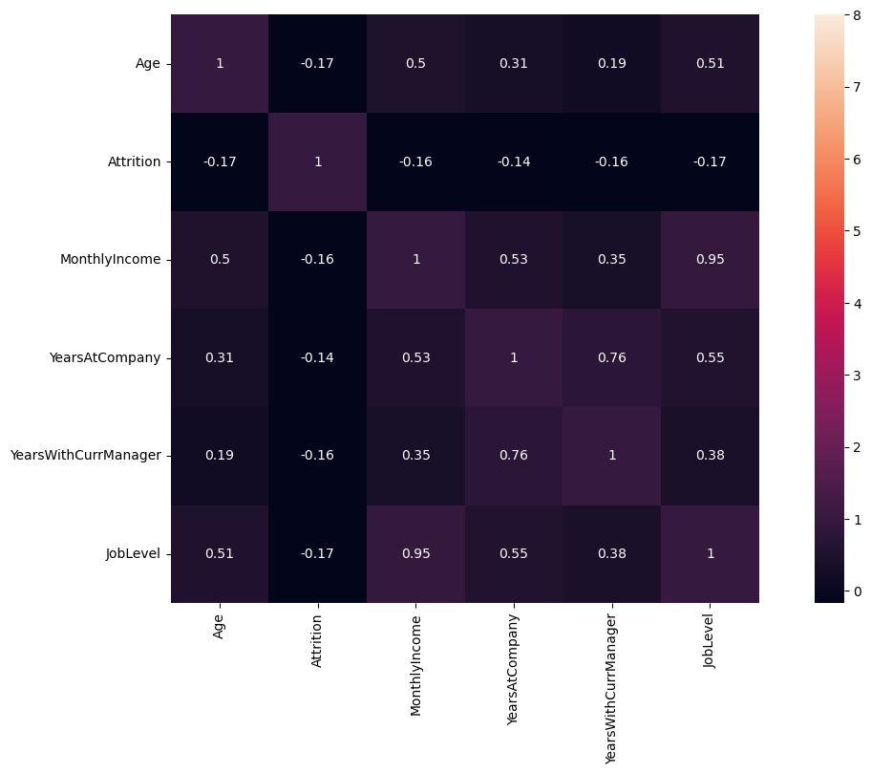
EXPLORATORY DATA ANALYSIS
MULTIVARIATE ANALYSIS (CORRELATION)
The analysis reveals that attrition is negatively correlated with the following factors:
Age
Monthly income
Years at the company
Years with the current manager
Job level
This means that as these factors increase, the likelihood of attrition decreases. In other words, older employees, those with higher monthly incomes, longer tenure, longer time with their current manager, and higher job levels tend to have lower rates of attrition.

Slide 19
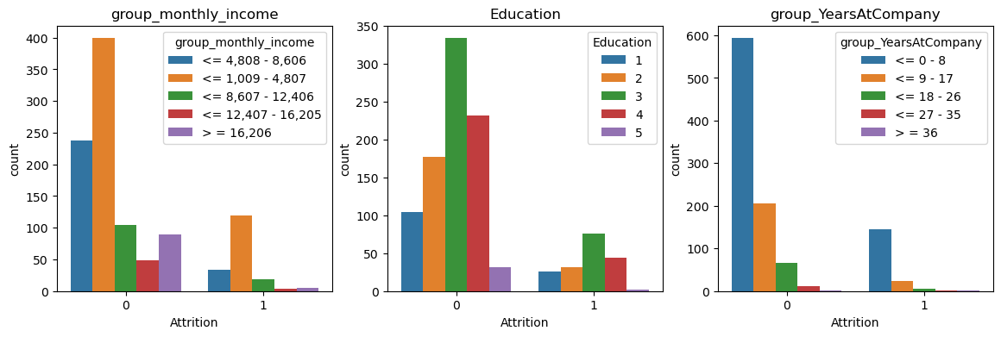
FEATURE ENGINEERING
RELATIONSHIP BETWEEN ATTRITION AND FEATURED ENGINEERED VARIABLES.
The data indicates a significant correlation between employee turnover and the following factors: lower monthly earnings (USD 1000-4800), shorter tenure (0-8 years), and skill levels 3. this suggests that the company is experiencing a disproportionate loss of employees within these demographics.

Slide 20
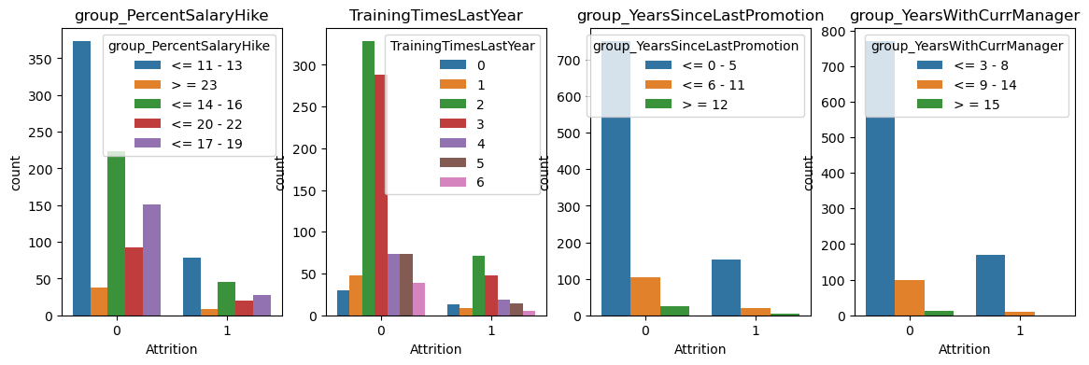
FEATURE ENGINEERING
RELATIONSHIP BETWEEN ATTRITION AND FEATURED ENGINEERED VARIABLES.
The dataset reveals that the employees who left the company typically had:
Received a salary increase of 11-13% or 14-16% in their last hike
Participated in 2, 3, or 1 training sessions last year
Received their last promotion 0-5 years ago
Been under the same manager for 3-8 years
This suggests that the company is losing employees who have recently received moderate salary increases, have had some training and development opportunities, and have been in their current role or under the same manager for a few years but may be seeking further opportunities or challenges.

Slide 21
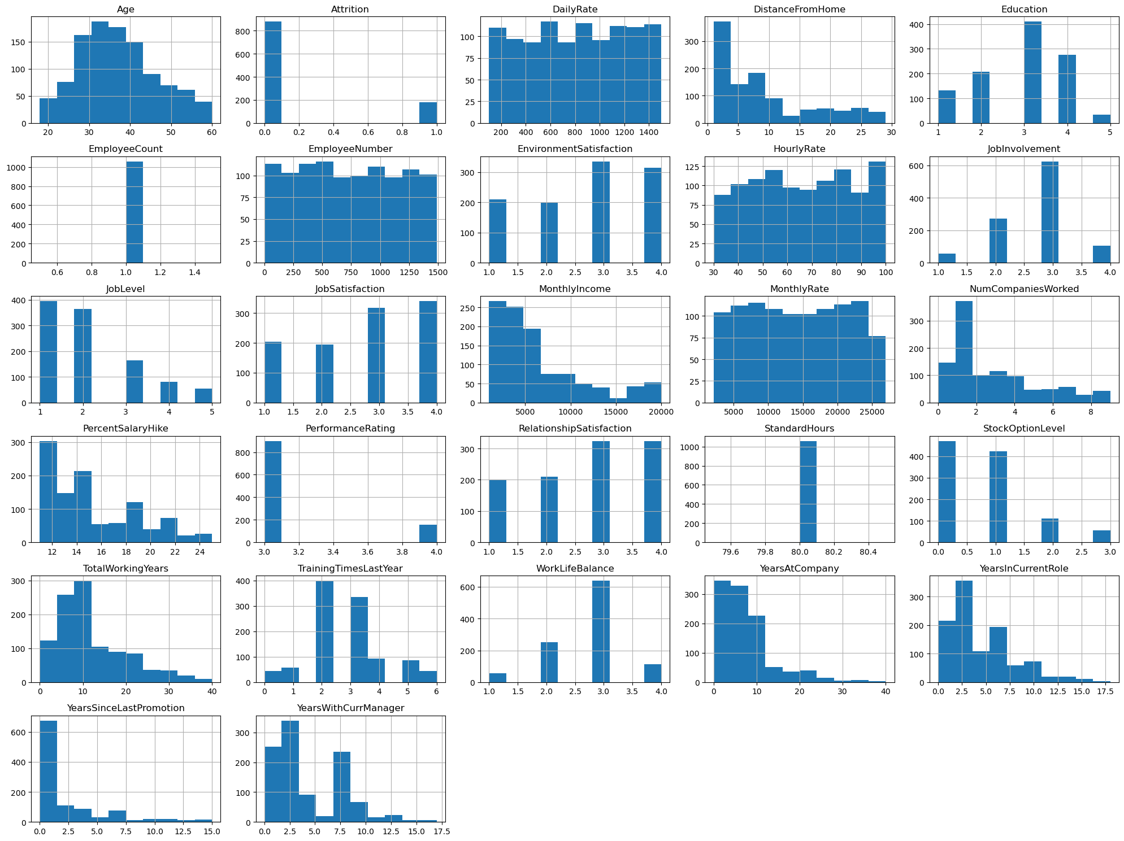
Relationship between Attrition and numerical variables.

Slide 22
DATA PREPROCESSING AND FEATURE IMPORTANCE/SELECTION
Dropping of redundant features
Encode the categorical features in the data
Segment dataset into data and target label
scale dataset features
Instantiating the scaler object
identifying key features from the data set
plotting a feature importance chart
Feature selection

Slide 23
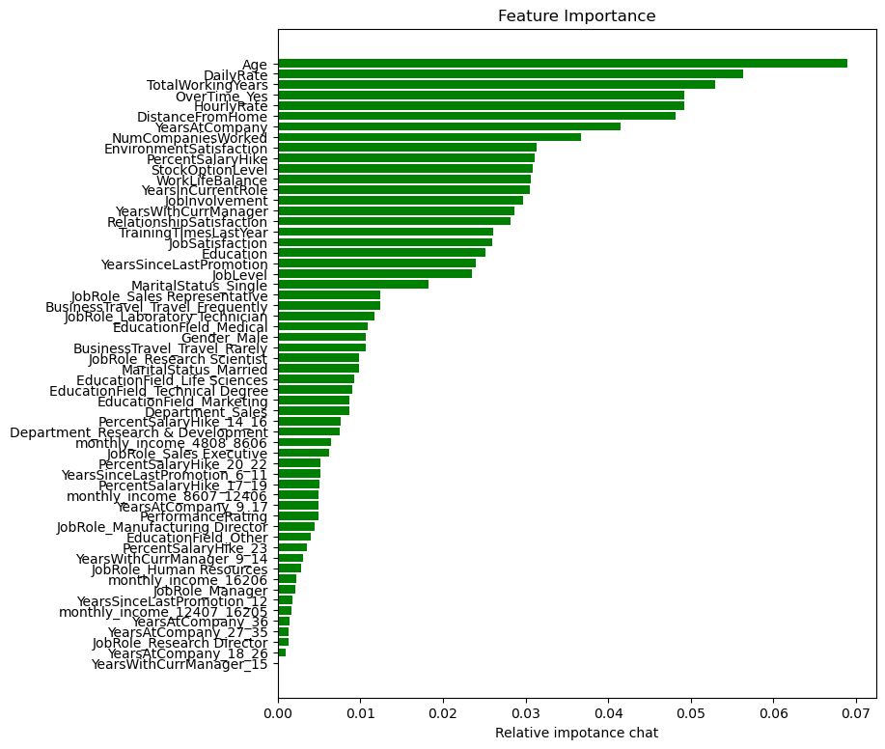
plotting a feature importance chart
The most significant predictors of attrition include:
Age
Daily rate
Total working years
Overtime
Hourly Rate
Distance from home
Years at the Company
Number of Companies worked
Environmental Satisfaction
Percentage Salary hike
Etc.
These features are crucial in predicting employee turnover, indicating that a combination of demographic, financial, work-related, and environmental factors contribute to an employee's likelihood of leaving the company.

Slide 24
Model development
Splitting data into training and evaluation datasets
Oversampling because the dataset is imbalance
Importing classifier libraries
Importing necessary modules
Perform cross-validation majorly to prevent overfitting
Model building using 7 machine learning Algorithms and evaluation.
Hyper Parameter Optimization Tunning of the 7 models.
Metrics Evaluation

Slide 25
Metrics Evaluation
Without tunning:
Analysis
Random forest is the best classifier for class 0, with a high accuracy rate and low error rate.
Logistic regression is the best classifier for class 1, with a high accuracy rate and low error rate.
Naive bayes has a high error rate for both class 0 and class 1.
Xgb classifier has a high error rate for class 1.
Overall, the models were poor in discriminating attrition and non attrition.
This requires further investigation using hyper parameter tunning.

Slide 26
HYPER PARAMETER OPTIMIZATION
Confusion Matrix for SVC:
[[69.33962264 12.26415094]
[12.26415094 6.13207547]]
Classification Report for SVC:
precision recall f1-score support
0 0.85 0.85 0.85 173
1 0.33 0.33 0.33 39
accuracy 0.75
AUC/ROC for SVC: 0.5915221579961464
Confusion Matrix for RFC:
[[74.52830189 7.0754717 ]
[13.20754717 5.18867925]]
Classification Report for RFC:
precision recall f1-score support
0 0.85 0.91 0.88 173
1 0.42 0.28 0.34 39
accuracy 0.80
AUC/ROC for RFC: 0.5976730398695717

Slide 27
HYPER PARAMETER OPTIMIZATION
Confusion Matrix for LR:
[[61.79245283 19.81132075]
[ 4.24528302 14.1509434 ]]
Classification Report for LR:
precision recall f1-score support
0 0.94 0.76 0.84 173
1 0.42 0.77 0.54 39
accuracy 0.76
AUC/ROC for LR: 0.7632281013783904
Confusion Matrix for XGBC:
[[73.58490566 8.01886792]
[12.26415094 6.13207547]]
Classification Report for XGBC:
precision recall f1-score support
0 0.86 0.90 0.88 173
1 0.43 0.33 0.38 39
accuracy 0.80
AUC/ROC for XGBC: 0.617533718689788

Slide 28
HYPER PARAMETER OPTIMIZATION
Confusion Matrix for SGDC:
[[77.83018868 3.77358491]
[13.20754717 5.18867925]]
Classification Report for SGDC:
precision recall f1-score support
0 0.85 0.95 0.90 173
1 0.58 0.28 0.38 39
accuracy 0.83
AUC/ROC for SGDC: 0.617904253742404
Confusion Matrix for GNB:
[[45.75471698 35.8490566 ]
[ 3.30188679 15.09433962]]
Classification Report for GNB:
precision recall f1-score support
0 0.93 0.56 0.70 173
1 0.30 0.82 0.44 39
accuracy 0.61
AUC/ROC for GNB: 0.6906032310656588

Slide 29
HYPER PARAMETER OPTIMIZATION
Confusion Matrix for DTC:
[[69.33962264 12.26415094]
[11.32075472 7.0754717 ]]
Classification Report for DTC:
precision recall f1-score support
0 0.86 0.85 0.85 173
1 0.37 0.38 0.37 39
accuracy 0.76
AUC/ROC for DTC: 0.617163183637172

Slide 30
Metrics Evaluation
Model Suitability Analysis for Imbalanced Dataset:
Logistic Regression (LR) stands out as the best model for predicting employee attrition. It has the highest recall (0.77) for the minority class, which is crucial in imbalanced classification problems. This high recall ensures that most employees likely to leave are correctly identified, which is critical in attrition prediction. Moreover, the AUC-ROC (0.76) indicates that it can effectively distinguish between those who stay and those who leave.
Random Forest Classifier (RFC) and XGBoost (XGBC) are good for the majority class but underperform for the minority class. Their precision and recall for class 1 are lower than LR, making them less suitable for detecting employee attrition cases in imbalanced datasets.
Gaussian Naive Bayes (GNB) offers the best recall (0.82) for the minority class, but its very low precision (0.30) means that it has a high false-positive rate. This could lead to unnecessary interventions for employees who are not likely to leave.
Support Vector Classifier (SVC), SGDC, and DTC offer moderate performance but lack the sensitivity needed for the minority class in terms of recall and precision.

Slide 31
Metrics Evaluation
Conclusion:
For predicting employee attrition in an imbalanced dataset:
Logistic Regression (LR) is the best choice, balancing recall for identifying those likely to leave while maintaining a good AUC-ROC. This is not robust for non –attrition cases
Gaussian Naive Bayes (GNB) could be considered if the primary concern is minimizing missed attrition cases, but its high false positives may be problematic.
Ensemble models like Random Forest and XGBoost are less suited due to their lower recall for the minority class.
The Confusion Matric indicates a relatively high FN which might be too costly for the Organization.
To enhance the rigor of our modeling, we must employ a Stacking Ensemble approach that leverages the synergy of strengths and weaknesses among multiple models, resulting in a robust and reliable prediction.

Slide 32
STACKING ENSEMBLE METHOD (CONFIGURATION)
For stacking ensemble models in the context of imbalanced datasets and employee attrition prediction, we need to choose base learners and a meta-learner that complement each other in terms of strengths and weaknesses. Here's an analysis of which models from the previous (tuned) results are suitable for stacking:
Base Learners: Base learners should be diverse and complement each other. A good ensemble should combine models that have different biases or approaches, improving the overall predictive power.
Logistic Regression (LR):
Strengths: High recall (0.77) for the minority class, making it excellent at catching attrition cases.
Weaknesses: Moderate precision.
Role: Ideal as a base learner because its linear nature and high recall can provide strong identification of class 1 (attrition) cases. It can capture the overall trend.
Random Forest Classifier (RFC):
Strengths: Strong performance for the majority class (class 0), with balanced performance overall.
Weaknesses: Weak minority class recall (0.28).
Role: RFC can be a strong base learner as its tree-based method captures non-linear relationships well, and its strength in class 0 compensates for weaknesses of models that focus more on the minority class.

Slide 33
STACKING ENSEMBLE METHOD (CONFIGURATION)
XGBoost Classifier (XGBC):
Strengths: Generally robust, handles non-linear patterns, and has a moderate recall (0.33) for the minority class.
Weaknesses: Slightly lower minority class recall than LR.
Role: XGBoost is another solid base learner, bringing in robust feature handling, especially for complex interactions between features.
Support Vector Classifier (SVC):
Strengths: Good balance of precision and recall for both classes.
Weaknesses: Lower overall recall for the minority class.
Role: SVC can be added to the stack, as its kernel-based approach complements the decision-based models (trees) and linear models (LR), helping to capture more nuanced decision boundaries.
Gaussian Naive Bayes (GNB):
Strengths: Excellent recall (0.82) for the minority class.
Weaknesses: Low precision for class 1 (attrition), meaning many false positives.
Role: GNB is useful in cases where sensitivity to the minority class is key. It can be a good base learner because its probabilistic approach may complement the deterministic methods of the other models.

Slide 34
STACKING ENSEMBLE METHOD (CONFIGURATION)
Meta-Learner:
The meta-learner will take the predictions from the base models and make the final prediction. It should be able to combine the strengths of the base learners effectively.
Logistic Regression (LR): Frequently used as a meta-learner because it performs well in linearly combining the outputs of base models. It is simple, interpretable, and tends to perform well when used as a second-level model in stacking ensembles.
XGBoost (XGBC) or Random Forest (RFC): Can also be strong choices for a meta-learner, as they can capture complex relationships between the base model predictions. However, they can overfit if the base learners are too similar.
Recommended Stacking Ensemble Configuration:
Base Learners:
Logistic Regression (LR): High recall and overall balanced performance.
Random Forest (RFC): Strong performance for class 0 and good handling of non-linear features.
XGBoost (XGBC): A powerful model for non-linear relationships, with moderate recall for class 1.
Gaussian Naive Bayes (GNB): High recall for the minority class, which may help reduce missed attrition cases.
Support Vector Classifier (SVC): Good balance between precision and recall, with kernel-based decision boundaries.
Meta-Learner:
Logistic Regression (LR) or XGBoost (XGBC): LR is preferred for its simplicity and generalization ability. XGBoost could be used if you suspect non-linear relationships between the base learners’ outputs.
This setup allows the ensemble to balance between catching the minority class (attrition cases) and not sacrificing too much precision, ultimately leading to a well-rounded predictive model suitable for the imbalanced dataset.

Slide 35
PRODUCTIONIZING OUR MODEL using stacking ensemble
Importing, detailed information on the new dataset.
Apply transforms to the new data similar to the training dataset by dropping off some redundant features and encode the categorical features to numerical ones
Import joblib
Load the saved base models and train with the best parameters for each algorithm
Generate meta-features for training the meta-learner.
Save the trained meta-learner to a file using joblib.dump
Make predictions with the base learners (Logistic Regression and XGBoost)
Create meta-features for the testing data and Load the meta-learner model
Make final predictions using the meta-learner
Apply cross-validation with stacking

Slide 36
METRIC EVALUATION OF STACKING ENSEMLE (CONFIGURATION)
Metric evaluation for class 0 and class 1
Accuracy: 0.9745
Precision (Class 0): 0.9666, Precision (Class 1): 0.9827
Recall (Class 0): 0.9830, Recall (Class 1): 0.9660
F1 Score (Class 0): 0.9747, F1 Score (Class 1): 0.9743
AUC-ROC: 0.9925
Confusion Matrix:
[[694 12]
[ 24 682]]

Slide 37
Analysis and Conclusion:
Overall Performance: The stacking ensemble has provided an exceptional level of performance, with high precision, recall, and F1 scores for both classes, as well as an almost perfect AUC-ROC score. This means that the model is very reliable for predicting employee attrition, which is challenging in imbalanced datasets.
Class Imbalance Handling: Both class 0 (stay) and class 1 (leave) are handled well. The model has a good balance of predicting those who will leave (class 1) with high recall (96.60%) and precision (98.27%), which is crucial in this context since identifying employees who are likely to leave is the main goal.
Trade-off Between Precision and Recall: The model achieves an excellent balance between precision and recall for both classes, particularly for the minority class (class 1), which is usually harder to predict. This indicates that the ensemble method has successfully learned from the base models and meta-learner to optimize performance across the classes. In summary, the stacking ensemble method is highly effective for this imbalanced dataset and is well-suited for predicting employee attrition. It strikes a good balance between minimizing false positives (predicting someone will leave when they won’t) and false negatives (failing to predict someone will leave), which is critical in employee retention strategies.

Slide 38
Impact of stacking ensemble on the 7 algorithms
Confusion Matrix for Logistic Regression:
[[49.2917847 0.7082153]
[ 1.9121813 48.0878187]]
Classification Report for Logistic Regression:
precision recall f1-score support
0 0.96 0.99 0.97 706
1 0.99 0.96 0.97 706
accuracy 0.97 1412
macro avg 0.97 0.97 0.97 1412
weighted avg 0.97 0.97 0.97 1412
AUC/ROC for Logistic Regression: 0.9737960339943342
Confusion Matrix for Random Forest:
[[49.07932011 0.92067989]
[ 1.62889518 48.37110482]]
Classification Report for Random Forest:
precision recall f1-score support
0 0.97 0.98 0.97 706
1 0.98 0.97 0.97 706
accuracy 0.97 1412
macro avg 0.97 0.97 0.97 1412
weighted avg 0.97 0.97 0.97 1412
AUC/ROC for Random Forest: 0.9745042492917846

Slide 39
Impact of stacking ensemble on the 7 algorithms
Confusion Matrix for XGBoost:
[[48.0878187 1.9121813 ]
[ 2.05382436 47.94617564]]
Classification Report for XGBoost:
precision recall f1-score support
0 0.96 0.96 0.96 706
1 0.96 0.96 0.96 706
accuracy 0.96 1412
macro avg 0.96 0.96 0.96 1412
weighted avg 0.96 0.96 0.96 1412
AUC/ROC for XGBoost: 0.9603399433427763
Confusion Matrix for Support Vector Classifier:
[[49.15014164 0.84985836]
[ 1.98300283 48.01699717]]
Classification Report for Support Vector Classifier:
precision recall f1-score support
0 0.96 0.98 0.97 706
1 0.98 0.96 0.97 706
accuracy 0.97 1412
macro avg 0.97 0.97 0.97 1412
weighted avg 0.97 0.97 0.97 1412
AUC/ROC for Support Vector Classifier: 0.971671388101983

Slide 40
Impact of stacking ensemble on the 7 algorithms
Confusion Matrix for Stochastic Gradient Descent Classifier:
[[48.58356941 1.41643059]
[ 2.26628895 47.73371105]]
Classification Report for Stochastic Gradient Descent Classifier:
precision recall f1-score support
0 0.96 0.97 0.96 706
1 0.97 0.95 0.96 706
accuracy 0.96 1412
macro avg 0.96 0.96 0.96 1412
weighted avg 0.96 0.96 0.96 1412
AUC/ROC for Stochastic Gradient Descent Classifier: 0.9631728045325779
Confusion Matrix for Gaussian Naive Bayes:
[[48.79603399 1.20396601]
[ 1.77053824 48.22946176]]
Classification Report for Gaussian Naive Bayes:
precision recall f1-score support
0 0.96 0.98 0.97 706
1 0.98 0.96 0.97 706
accuracy 0.97 1412
macro avg 0.97 0.97 0.97 1412
weighted avg 0.97 0.97 0.97 1412
AUC/ROC for Gaussian Naive Bayes: 0.9702549575070821

Slide 41
Impact of stacking ensemble on the 7 algorithms
Confusion Matrix for Decision Tree Classifier:
[[49.15014164 0.84985836]
[ 2.33711048 47.66288952]]
Classification Report for Decision Tree Classifier:
precision recall f1-score support
0 0.95 0.98 0.97 706
1 0.98 0.95 0.97 706
accuracy 0.97 1412
macro avg 0.97 0.97 0.97 1412
weighted avg 0.97 0.97 0.97 1412
AUC/ROC for Decision Tree Classifier: 0.968130311614731

Slide 42
Analysis and Conclusion:
The output shows performance results for seven tuned models (Logistic Regression, Random Forest, XGBoost, Support Vector Classifier, Stochastic Gradient Descent Classifier, Gaussian Naive Bayes, and Decision Tree Classifier) used in a stacking ensemble method to predict a classification task.
Performance Overview
Across all models, the performance metrics are consistently strong, with accuracies around 96-97%, and high precision, recall, and F1 scores. This indicates that each model individually performs well, likely contributing positively to the stacking ensemble.
The confusion matrices reveal that:
Class 0 (Majority Class): All models consistently show low false positive rates (misclassifying class 1 as class 0), with errors generally ranging from 0.7% to 1.9%. Random Forest and Logistic Regression perform exceptionally well in this aspect.
Class 1 (Minority Class): The models show a similar trend, with false negatives (misclassifying class 0 as class 1) ranging from 1.6% to 2.3%. Logistic Regression, Random Forest, and Support Vector Classifier have fewer false negatives than XGBoost and SGD.

Slide 43
Comparative Evaluation Performance on stack ensemble technique class 1 vs individual tuned/optimized algorithms class 1 (Attrition)
This compares the performance of a stacked ensemble technique and individual tuned/optimized algorithms in predicting employee attrition. The ensemble technique outperforms individual tuned algorithms in:
1. Accuracy: Ensemble (96%-97%) vs. Individual algorithms (61%-83%)
2. Precision (Class 1 - Attrition): Ensemble (0.96-0.99) vs. Individual algorithms (0.30-0.42)
3. Recall (Class 1 - Attrition): Ensemble (0.95-0.98) vs. Individual algorithms (0.28-0.77)
4. F1-Score (Class 1 - Attrition): Ensemble (0.96-0.97) vs. Individual algorithms (0.33-0.54)
5. AUC/ROC: Ensemble (0.96-0.97) vs. Individual algorithms (0.59-0.76)
The ensemble technique provides more consistent and accurate predictions, making it a more reliable approach for HR decision-making, especially in predicting employee turnover or identifying high-potential candidates for promotions. Additionally, the ensemble technique handles class imbalance more effectively, which is critical in HR settings where false negatives (missed attrition cases) are costly.

Slide 44
Comparative Evaluation Performance on stack ensemble technique class 0 vs individual tuned/optimized algorithms class 0 (Non – Attrition)
This compares the performance of a stacked ensemble technique and optimized algorithms in predicting class 0 (non-attrition). The metrics used are precision, recall, F1-score, and AUC/ROC. The results show that the stacked ensemble consistently outperforms the optimized algorithms in all metrics, demonstrating better accuracy, reliability, and discrimination between non-attrition and attrition cases.
Key findings:
- Precision: Stacked ensemble (0.95-0.97) vs. Optimized algorithms (0.85-0.94)
- Recall: Stacked ensemble (0.97-0.99) vs. Optimized algorithms (0.56-0.95)
- F1-Score: Stacked ensemble (0.96-0.97) vs. Optimized algorithms (0.70-0.90)
- AUC/ROC: Stacked ensemble (0.96-0.97) vs. Optimized algorithms (0.61-0.76)
The stacked ensemble shows superior performance in predicting non-attrition, with higher precision, recall, F1-score, and AUC/ROC values. This indicates that the ensemble is better at identifying true non-attrition cases while minimizing errors, making it a more reliable approach for predicting class 0 (non-attrition).

Slide 45
Comparative Evaluation of the Confusion Metric Performances on stack ensemble technique vs individual tuned/optimized algorithms
• Stacked Ensemble: Across models, the number of misclassified instances (both false positives and false negatives) is consistently low. For instance, for Logistic Regression in the ensemble, there are approximately 2 false negatives and 1 false positive, which is highly efficient for HR decision-making.
• Tuned/Optimized Algorithms: For individual models, the number of misclassified instances is notably higher. For example, the Random Forest Classifier shows 13 false negatives and 7 false positives, and Gaussian Naive Bayes shows an even more imbalanced misclassification, with 35 false positives.

Slide 46
Analysis and Conclusion:
The stacking ensemble approach has achieved excellent results by combining the strengths of multiple algorithms, including Logistic Regression, XGBoost, and others. The ensemble has demonstrated robust predictive performance, generalizing well on test data. The success of the ensemble can be attributed to the complementary strengths of its base models, with Logistic Regression and XGBoost providing strong generalizations, and other models offering nuanced decision boundaries. With each base model performing well, the ensemble is likely to be robust and outperform individual models. Overall, the stacking ensemble approach has yielded a powerful and generalizable predictive model.

Slide 47
RECOMMENDATION
Recommendations for Reducing Employee Attrition:
Focus on retaining experienced employees
Offer competitive compensation
Promote work-life balance
Provide recognition and career growth opportunities
Enhance environmental satisfaction
Invest in training and development
Provide managerial support
Boost employee engagement
Leverage predictive modeling
Continuously monitor attrition trends

Slide 48
RECOMMENDATION
Recommendations for Predictive Modeling of Employee Attrition Using Stacking Ensemble:
Stacking ensemble method combine the strengths of multiple models to give a synergy effect on the metrics
Strategic Benefits for HR:
Proactive retention
Optimized resource allocation
Data-driven insights
Improved employee engagement
Handling imbalanced data which is common with the HR
Next Steps for Implementation:
Model deployment
Incorporate deep learning models into the ensemble to capture complex relationships in the data.
Apply natural language processing (NLP) on unstructured data such as employee feedback or performance reviews.
Continuous monitoring and tuning
Integrate employee engagement surveys
By implementing these recommendations, organizations can reduce employee attrition, improve employee satisfaction, and enhance overall performance.

Slide 49
THANK YOU

